Slide 1






THE IMPACT OF WARS ON THE STRUCTURE OF SOCIETY:
A COMPARATIVE STUDY OF GAZA, SYRIA, SUDAN, AND UKRAINE

Slide 2




TEAM MEMBERS
Mennatullah Ahmed (LEADER)
Kareema Hesham
Asmaa Abolyazed
Nahed Mostafa
Muhammed Osama
Mostafa Elzantoot
Mostafa Elfrmawy
Eng: Eman Ghanem (Instructor)

Slide 3
INTRODUCTION
Wars have significant impacts on countries across multiple sectors, not only through physical destruction but also through long-term economic, social, educational, health, and food-related consequences.
This presentation provides a data-driven analysis of four conflict-affected regions: Gaza, Syria, Sudan, and Ukraine.
Our goal is to examine how key indicators in these countries changed during periods of conflict and whether war was the main driver behind these changes.

Slide 4
BACKGROUND
Each of the selected regions has experienced prolonged or intense conflict:
Gaza: Repeated wars and ongoing blockade affecting economy and services.
Syria: Civil war since 2011 causing displacement and infrastructure damage.
Sudan: Political instability and internal conflict impacting development.
Ukraine: Conflict since 2014 and full-scale invasion in 2022 disrupting economy and trade.
The study uses historical indicators related to:
GDP, trade, unemployment
School enrolment & educational damage
Health system capacity
Crop production & food security
Understanding the background helps us identify baseline conditions before the wars.

Slide 5
PROBLEM
Despite the availability of data, it is often unclear whether the negative shifts in economic, social, health, and educational indicators are caused directly by war or by other factors.
Many of the observed changes could result from:
Global crises (e.g., COVID-19)
Economic sanctions
Climate shocks affecting agriculture
Internal political instability
Supply chain disruptions
Therefore, the main problem is:
How can we distinguish the true impact of war from other external or internal factors across Gaza, Syria, Sudan, and Ukraine?

Slide 6
PROJECT PROCESS
We searched through many sources such as the World Bank, FAO, UNICEF, UNESCO, the United Nations, the World Health Organization, the Red Crescent, and various other platforms to obtain reliable real-world data for our analysis.

Slide 7
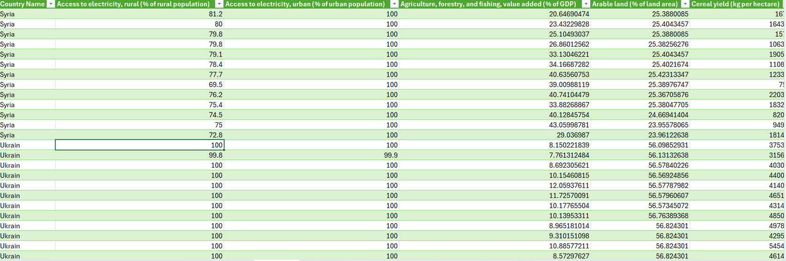
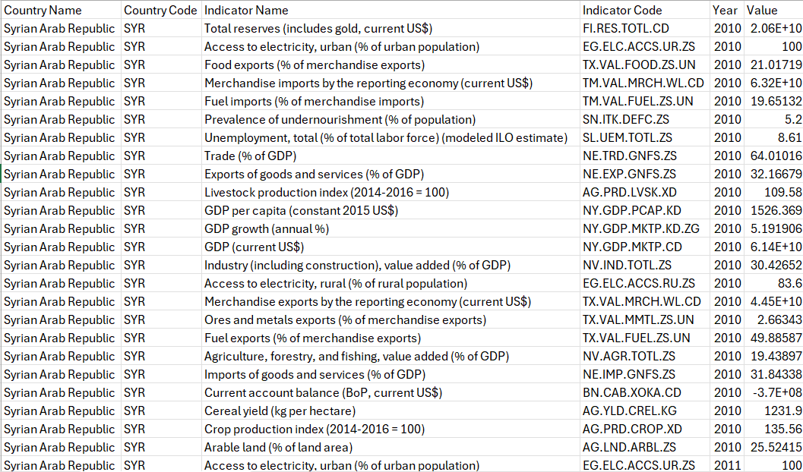
ECONOMIC
"The indicator was changed from rows to columns, and each indicator served as the title for a column with the values for each country in each year listed beneath it."

Slide 8
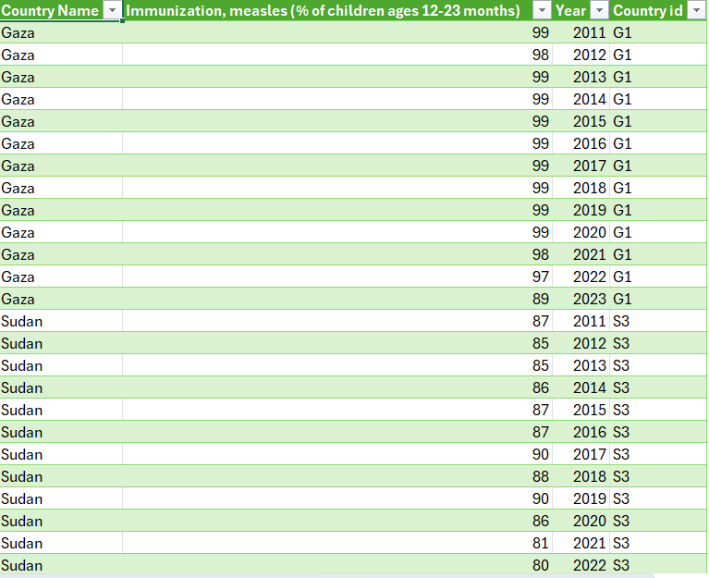
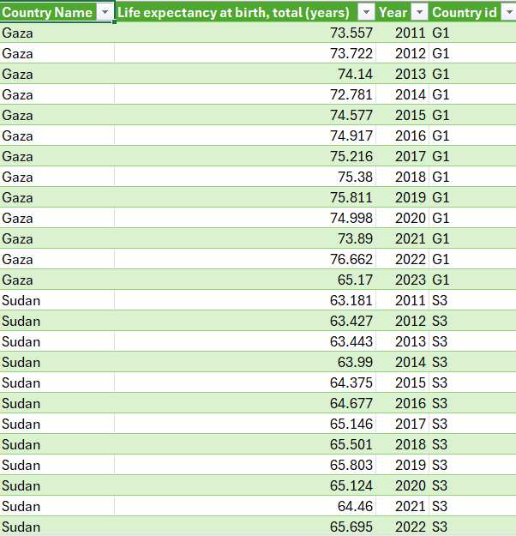
HEALTH
"The indicator was changed from rows to columns, and each indicator served as the title for a column with the values for each country in each year listed beneath it."

Slide 9
PROJECT PROCESS
Due to the difference in sources and websites/online sources, there were discrepancies in the names of the countries, their order, and the order of the years. The data was processed by unifying all country names across all sheets, ordering the countries, and unifying the information across all sheets.

Slide 10
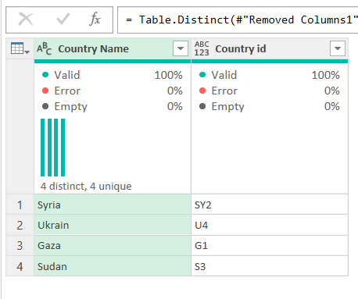
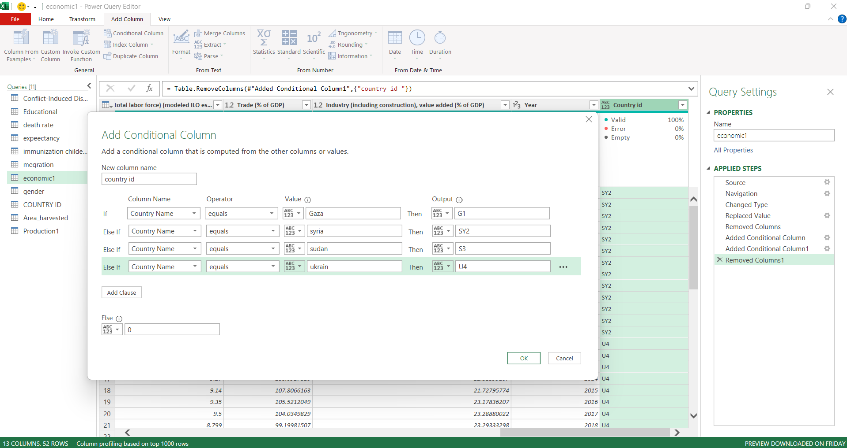
MODELING
To avoid data duplication and creating incorrect relationships, we generated a unique country ID in every sheet using a conditional column and created a new table named 'Country ID' to act as a linking intermediary between the sheets, thus preventing repetition.

Slide 11
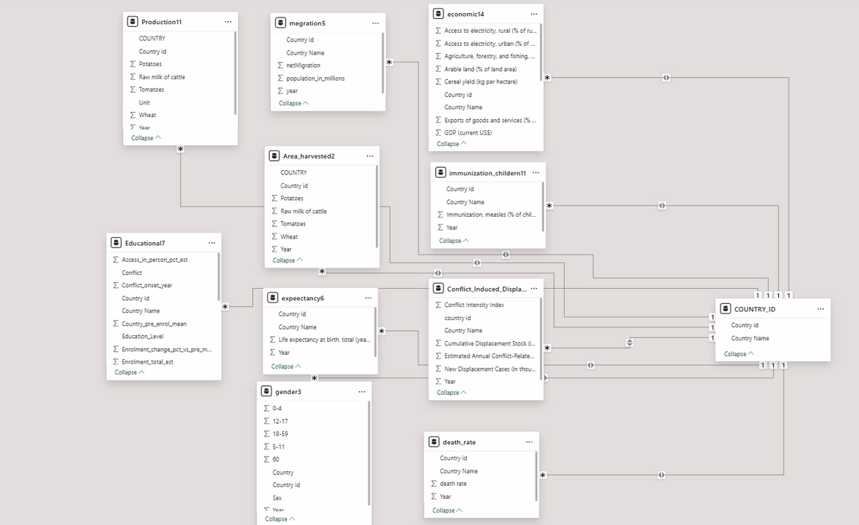
MODELING
After the 'Country ID' table was created, all sheets were linked. The relationship established between them all was many-to-one, and the data was successfully connected."

Slide 12
INSIHTS
What is the rate of wheat production over the years in countries?
What is the rate of tomato production over the years in countries?
What is the impact/trend of Goods and Services Exports (as a % of GDP) in various countries?
How has cereal production been affected over the years?
What has been the long-term impact of trade on domestic production?
What is the most significant factor affecting domestic production?
Which country reported the highest number of damaged schools during the conflict period?
How does enrolment compare vs. pre-conflict baseline?
Which year and country has the highest number of student killed?
4-Which country has the highest remote access?
How has the production/market of dairy products been affected over the years?

Slide 13
INSIHTS
What is the rate of change in 'Life expectancy at birth, total (years)' across countries over the years?
What is the current recording/prevalence of 'Immunization, measles (% of children ages 12-23 months)' in various countries?
What are the historical trends in the death rate across countries?
What is the change in population across the years, and how does this relate to aggregate cases of displacement, deaths, and disappearances?
What is the variance/change in 'New Displacement Cases (in thousands)' across countries?
What is the rate of change in 'Estimated Annual Conflict-Related Deaths' in various countries?
Which country records the highest 'Cumulative Displacement Stock (in millions)'?

Slide 14
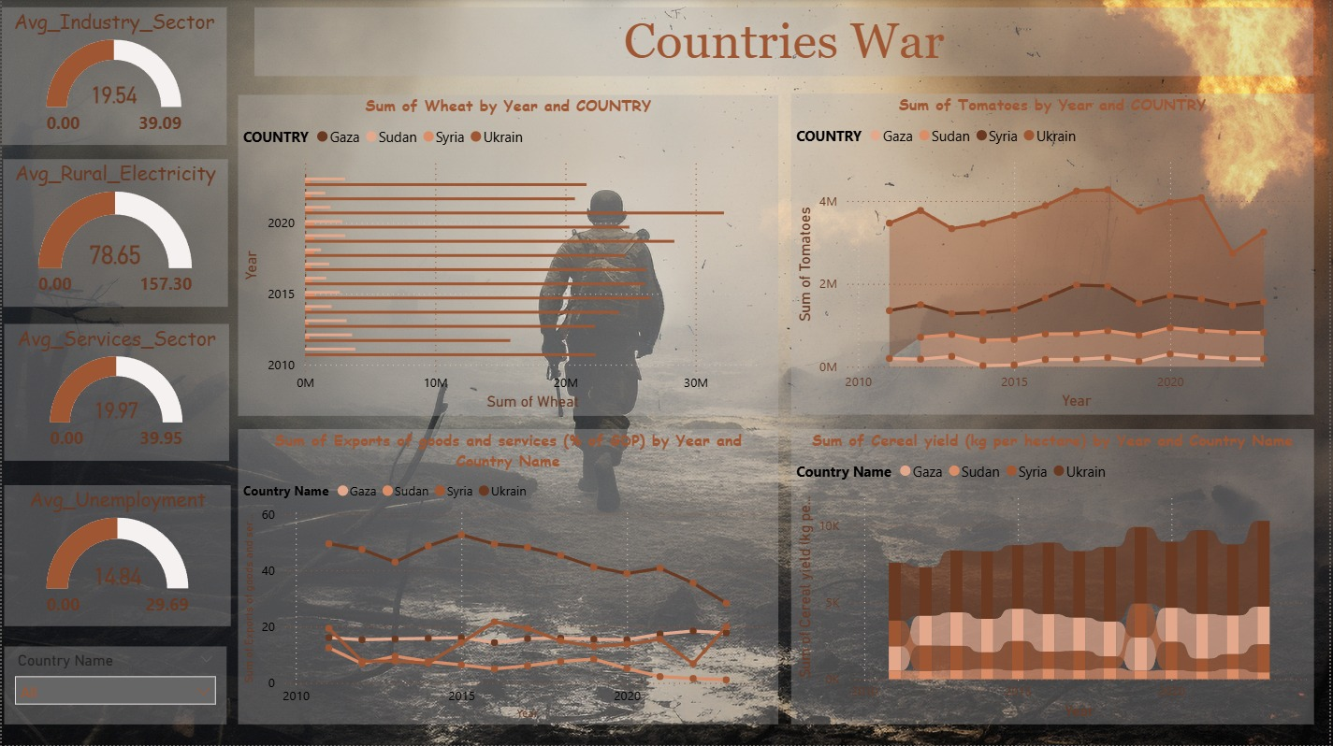

Slide 15
WHEAT
TOMATO
Ukraine: War + bad climate + logistics issues.
Syria: Civil war + drought + sanctions + input shortages.
Sudan: Instability + inflation + floods/drought + weak irrigation.
Gaza: 2021 war + blockade + limited land + water issues
Ukraine: War + energy costs + damaged farms
Syria: Civil war + drought + weak irrigation + pests
Sudan: High costs + pests + seasonal issues + low inputs
Gaza: Conflict + blockade + destroyed greenhouses + water shortags
DECLINE IN EXPORTS
CEREAL YEILD
Ukraine: War + port shutdowns + high logistics costs + lower production.
Syria: Long war + sanctions + currency collapse + low production.
Sudan: Conflict + inflation + weak infrastructure + lower export output.
Gaza: Blockade + repeated wars + limited resources + weak economy.
Ukraine: War + climate issues + logistics
Syria: Civil war + drought + sanctions + input shortages
Sudan: Instability + inflation + floods/drought + weak irrigation
Gaza: Blockade + limited land + water issues

Slide 16
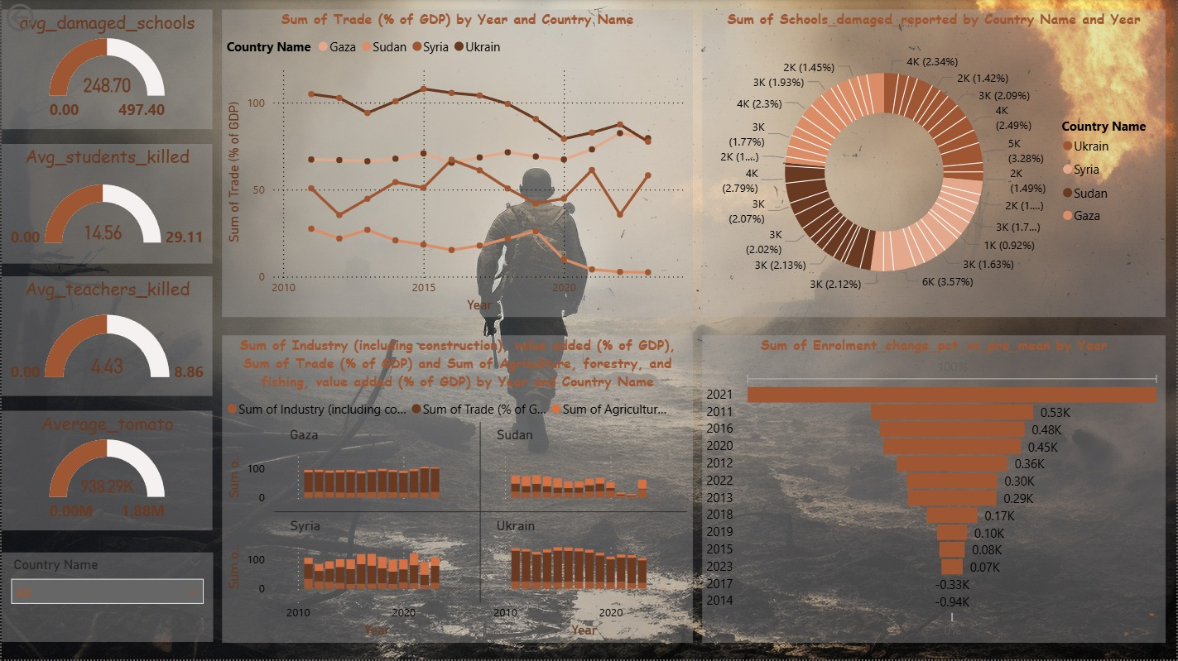

Slide 17
TRADE
SCHOOLS DAMAGE
Ukraine: 2019 weak economy + 2022 war + infrastructure damage
Syria: 2019 weak production + sanctions + 2022 civil war + infrastructure damage
Sudan: 2020–2023 covid + economic crisis + floods + high costs
Gaza: 2020 covid + closures + 2023 war + blockade + halted production
Ukraine: War + migration + low birth rates + logistical problems.
Gaza: Repeated wars + blockade + schools used as shelters + bombing.
Sudan: Armed conflict + floods + displacement + weak infrastructure.
Syria: Civil war + displacement + blockade + bombing + schools used for military purposes.
INCOME
ENROLMENT CHANGE
The local income in these countries was weak due to wars, economic crises, and restrictions on local production, while trade often continued or was necessary to meet needs, which is why it recorded a higher income compared to local income.
Ukraine: war + displacement + destroyed schools + COVID + remote learning
Gaza: 2021 war + blockade + limited land + water issues
Sudan: political instability + internal displacement + floods/drought + weak education
Syria: civil war + internal & external displacement + destroyed schools + remote learning

Slide 18
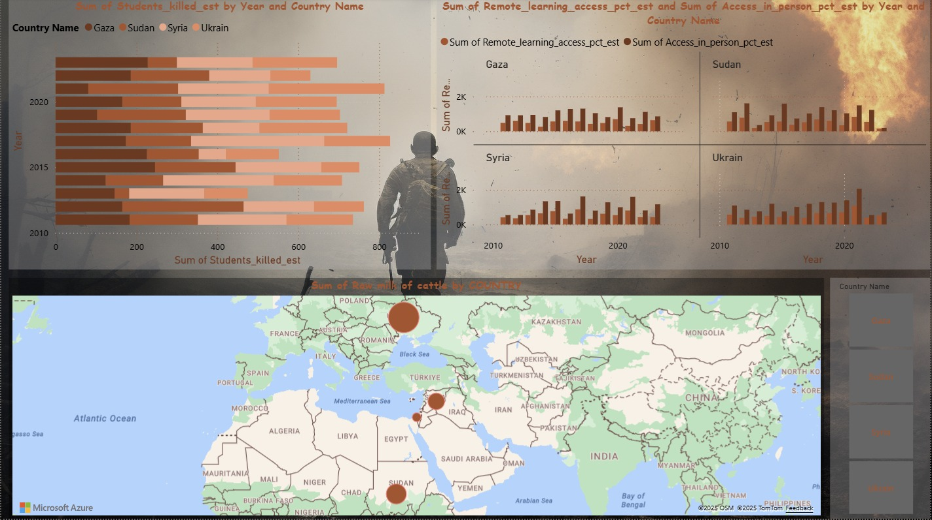

Slide 19
STUDENTS KILLED
REMOTLY \ IN PERSON
Ukraine (2021 & 2023): War + school attacks + airstrikes + limited emergency services.
Syria (2014 & 2017): Civil war + bombing + explosions + poor healthcare.
Sudan (2012, 2014 & 2021): Local conflicts + floods/drought + weak health infrastructure.
Gaza (2015, 2022 & 2023): Wars/escalation + blockade + school destruction + limited medical aid.
Ukraine 2022-2023: War → schools destroyed + displacement → low enrolment and limited online learning.
Syria 2022-2023: Civil war → schools destroyed + displacement → low enrolment and limited online learning.
Sudan 2013-2023: Conflicts and instability → school disruption + weak internet → limited online learning.
Gaza 2014-2021-2023: Wars + blockade → schools destroyed + limited internet → low enrolment and limited online learning.
RAW OF MILK
Limited agricultural land → less feed production for animals.
Blockade and restricted trade → difficulty importing production supplies or exporting products.
Water and irrigation issues → limited water affects animal rearing and milk production.
Economic challenges → high costs and difficulty accessing equipment and feed.

Slide 20
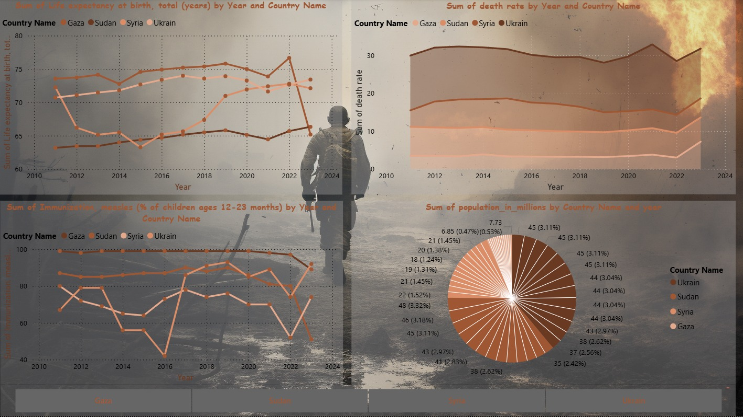

Slide 21
HEALTH
From 2010 to 2013, health conditions across Ukraine, Gaza, Sudan, and Syria were relatively stable, with life expectancy ranging from 70–75 years in Ukraine and Gaza and 62–65 years in Sudan and Syria, low death rates, and strong child immunization. Syria experienced a major shock from 2011 to 2016 due to war, with life expectancy dropping from 65 to 62 years, death rates rising sharply, and measles immunization falling from 90% to below 60%, heavily affecting children. Gaza faced repeated shocks between 2012 and 2023, with fluctuating life expectancy and death rates, repeated immunization collapses followed by fragile recoveries, and a healthcare system repeatedly overwhelmed. Sudan experienced a slow structural collapse from 2015 to 2024, with steadily rising death rates, immunization coverage sometimes falling below 50–55%, and unstable life expectancy. Ukraine faced a sudden shock in 2022, with life expectancy starting to decline, death rates spiking, and immunization coverage dropping. Populations were also heavily affected: Ukraine and Syria experienced large-scale migration, Sudan faced internal displacement, and Gaza suffered extreme population density. The core message is clear: war does not kill just once—it kills slowly every year, shortening lifespans, leaving children unvaccinated, collapsing healthcare systems, and displacing millions.
.

Slide 22
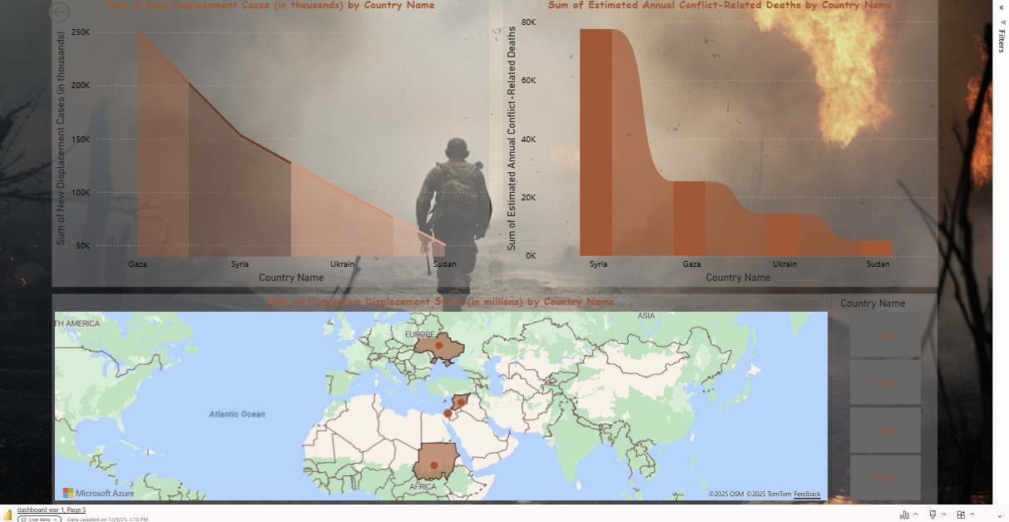

Slide 23
SOCIAL
From 2011 to 2024, conflicts in Syria, Gaza, Ukraine, and Sudan caused massive and repeated displacement and deaths, each with distinct patterns. Syria experienced the longest continuous bloodshed, with 75,000–80,000 deaths annually at its peak and millions displaced. Gaza faced extreme military pressure in a small area, displacing 250,000 people in waves, with 25,000 deaths. Ukraine saw a sudden large-scale shock after 2022, displacing 100,000 and causing 15,000 deaths, while Sudan experienced a slow, systemic collapse with 60–70,000 displaced and 5,000 deaths. The real impact is not only the numbers but where people are trapped, showing that war inflicts cumulative, long-term societal damage rather than instant destruction.

Slide 24
EDUCATION
In Ukraine, rebuilding damaged schools, improving infrastructure, expanding remote learning through internet and mobile devices, providing psychological support for students and teachers, and protecting schools from attacks are key priorities. In Syria, solutions include rehabilitating schools with safe facilities, distributing remote learning tools, training teachers for conflict-affected environments, and offering psychosocial support to students. Sudan should focus on constructing disaster-resilient schools, enhancing rural education via mobile technology, training teachers for unstable conditions, and supporting families to ensure children’s continuity in education. In Gaza, rebuilding schools quickly, improving electricity and internet access for remote learning, providing psychosocial support, and offering flexible educational alternatives during blockades or attacks are essential.

Slide 25
ECONOMIC
In Ukraine, priorities include supporting local production in agriculture and small-to-medium industries, improving logistics and transport to reduce losses, promoting safe and sustainable foreign trade, and providing small- and medium-sized financing programs for families and local businesses. In Syria, solutions focus on supporting farmers and small factories with production inputs, boosting local production of food and essential goods, easing humanitarian sanctions with transparency, and strengthening internal and external trade to reduce import dependence. Sudan should enhance agricultural and irrigation infrastructure to combat droughts and floods, support small and medium enterprises, stabilize inflation through financial policies, and promote local trade to meet domestic demand. In Gaza, opening safe trade channels, reducing import/export restrictions, supporting small businesses, improving agricultural land and water supply, and offering youth training for small economic projects are key measures.

Slide 26
HEALTH
In Ukraine, key measures include rebuilding hospitals and health centers in affected areas, providing essential medicines and vaccines for children, training healthcare workers for emergencies and conflict situations, and supporting the mental health of civilians and displaced populations. In Syria, solutions involve expanding access to primary healthcare in besieged areas, conducting vaccination campaigns for children and pregnant women, deploying mobile hospitals and medical centers in hard-to-reach regions, and offering psychosocial support to war-affected populations. Sudan should focus on improving healthcare infrastructure to address conflicts and disasters, conducting vaccination and disease control campaigns, training medical teams for natural disasters and emergencies, and ensuring access to clean water and sanitation. In Gaza, priorities include repairing and equipping health facilities, running vaccination programs, supporting mental health after trauma and conflict, and improving medical supplies and pharmaceutical availability.

Slide 27
FEED
In Ukraine, solutions include supporting agriculture and rehabilitating damaged land, improving storage and transport systems to reduce losses, providing small farmers with inputs, fertilizers, and equipment, and developing food security programs for the most affected areas. In Syria, priorities involve irrigation programs and cultivating drought-resistant crops, supplying basic agricultural inputs at subsidized prices, boosting local production of vegetables and grains, and improving food supply chains to minimize waste. Sudan should focus on enhancing irrigation, combating droughts and floods, supporting small farmers and agricultural cooperatives, creating safe food storage to mitigate emergencies, and training farmers in sustainable agriculture. In Gaza, key measures include improving farming on limited land using vertical or protected agriculture, enhancing water and irrigation supplies, providing inputs and fertilizers to farmers, and implementing food security programs for the most vulnerable households.

Slide 28
SOCIAL
In Ukraine, key measures include psychosocial support programs for displaced people and children, supporting affected communities through employment and education opportunities, and rebuilding social connections via community activities. In Syria, solutions involve resettlement programs for displaced populations, providing social and psychological assistance to women and children, and promoting social cohesion and community participation. Sudan should focus on supporting communities affected by conflicts and natural disasters, implementing programs to strengthen community peace and local reconciliation, and assisting the poorest families to ensure social stability. In Gaza, priorities include psychosocial support for children and women, rebuilding civil society after conflicts, and supporting small projects to revive economic and social networks.

Slide 29
CONCLUSION
Conflicts in Ukraine, Syria, Sudan, and Gaza have caused massive displacement, severely affecting vulnerable populations, especially children. Wars and crises have reduced access to healthcare and education, while local production and income have dropped, making trade essential for survival. Agricultural production, including key crops and dairy, has declined due to conflict, adverse climate conditions, and logistical challenges. Addressing these challenges requires integrated humanitarian, social, and economic interventions, alongside programs that support psychological well-being, community cohesion, and recovery efforts.

Slide 30
THANK YOU

